Slide 1
Prerequisites - Running LLMs on Prem
Create a Google Account (if you do not have one, yet): https://accounts.google.com/
Login with that account into Google Colab: https://colab.research.google.com/
Create a Huggingface account (if you do not have one, yet): https://huggingface.co/join
Create an access token and save it for later use in the notebooks: https://huggingface.co/settings/tokens
Request access to gated Huggingface models:
https://huggingface.co/meta-llama/Meta-Llama-3.1-8B-Instruct
https://huggingface.co/google/gemma-2-2b-it
Make sure you can open the workshop notebooks in Colab: https://colab.research.google.com/github/DJCordhose/practical-llm

Slide 2
Running LLMs on prem
A Practical Guide

Slide 3
Our Prep
Before travel
Fill in speaker form for requirements
Have a fallback for WiFi outage
Download these slides as PDF
Clone repo with latest version of https://colab.research.google.com/github/DJCordhose/practical-llm
On Site
Figure out speaker WiFi
Show prerequisites as first slide before beginning of workshop

Slide 4
Aktuelle Notebooks
Use case als Teil des ersten Notebooks
Evidently Eval: https://colab.research.google.com/drive/1JHhM-flsmn-AIxrs0f3Bh3AjjdBnNLHT#scrollTo=U7aJCgFdwx6K

Slide 5
TODO
Decoder Skizze in ordentlich und in Englisch
Who are we Folie
Key takeaways

Slide 6
Intro

Slide 7
Why self hosting an LLM?
You might want control over
Privacy / data protection
Availability and Scaling
Latency
Limitations
Cost of operation
Ecological footprint
Stability

Slide 8
Most important - Privacy / data protection
your data remains in your local networks
https://artificialintelligenceact.eu/
Requires special care for high risk applications
https://gdpr-info.eu/
At least makes processing outside the EU more cumbersome

Slide 9
Often overlooked - Stability
Users want stability, not drastic changes over night (even when they are for the better)
Changing your model will likely impact behavior and performance
Almost like changing a person
Prompts often optimized for a specific model and version
Example GPT 3.5 on Azure
https://learn.microsoft.com/en-us/azure/ai-services/openai/concepts/model-retirements
https://platform.openai.com/docs/models/gpt-3-5-turbo
https://platform.openai.com/docs/deprecations
Additionally, you are not limited to whatever is available by your provider in your region

Slide 10

Architecture Decision: self-hosting ?
Decision : yes
Key-Driver : privacy, version stability, limitations
Challenge : which LLM ? Does it run on your hardware ?
Surprises : operating GPUs is really hard
Failures
Power
Stability
Complexity, Work, Troubles

Slide 11
This workshop is about solving the challenges arising from self hosting

Slide 12
Agenda
Past - Encoder Models
Present - quantized / smaller Decoder Models
Future - larger Decoder Models
Evaluation

Slide 13
Who are we?
Christian
Olli

Slide 14
Who are you?
Talk to each other

Slide 15
LLM Intro

Slide 16

How does a Decoder Model work ?
Q: what is pluvia ?
A:
Depends on users goal
Unique for each chat & user
Contains the chat history
«the context»
Trained on huge datasets
Does not change
Same for all users
«the model»

Slide 17
How does an LLM work ?
Q: what is pluvia ?
A:
Pluvia
Depends on users goal
Unique for each chat & user
Contains the chat history
«the context»
Trained on huge datasets
Does not change
Same for all users
«the model»
Single «word»
Depends on context and model
«the token»

Slide 18
How does an LLM work ?
Q: what is pluvia ?
A: Pluvia
is
Depends on users goal
Unique for each chat & user
Contains the chat history
«the context»
Trained on huge datasets
Does not change
Same for all users
«the model»
Single «word»
Depends on context and model
«the token»

Slide 19
How does an LLM work ?
Q: what is pluvia ?
A: Pluvia is
a
Depends on users goal
Unique for each chat & user
Contains the chat history
«the context»
Trained on huge datasets
Does not change
Same for all users
«the model»
Single «word»
Depends on context and model
«the token»
Represented as an int id

Slide 20
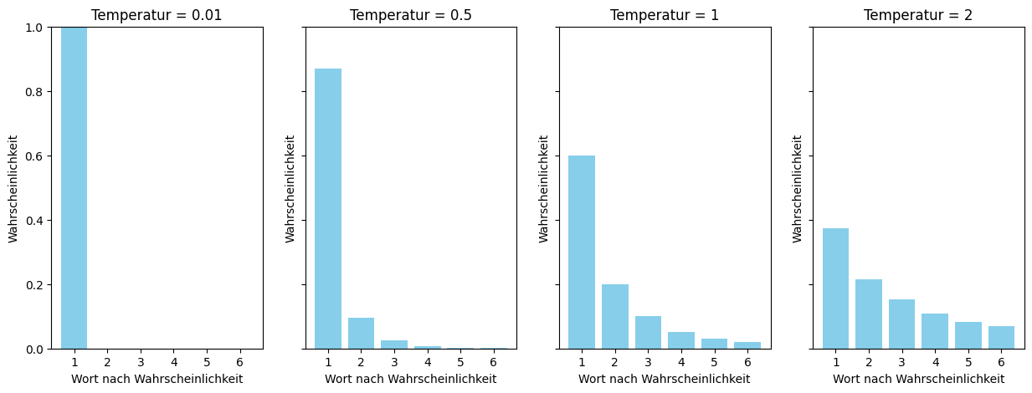
How does an LLM work ?
Q: what is pluvia ?
A: Pluvia is a
2.78
0.02
98.7
-23
…
latin
[312, 2,17,…]
Depends on users goal
Unique for each chat & user
Contains the chat history
«the context»
A list of token ids
Trained on huge datasets
Does not change
Same for all users
«the model»
Output a probability distribution over token ids
Single «word»
Depends on context and model
«the token»
Represented as an int id

Slide 21
How does an LLM work ?
Q: what is pluvia ?
A: Pluvia is a latin
4
17.2
-33
0.01
…
…
[312, 2,17,…]
Depends on users goal
Unique for each chat & user
Contains the chat history
«the context»
A list of token ids
Trained on huge datasets
Does not change
Same for all users
«the model»
Output a probability distribution over token ids
Single «word»
Depends on context and model
«the token»
Represented as an int id

Slide 22
How does an LLM work ?
Q: what is pluvia ?
A: Pluvia is a latin word meaning rainfall.
0.2
29.4
95
567
…
EOT
[312, 2,17,…]
Depends on users goal
Unique for each chat & user
Contains the chat history
«the context»
A list of token ids
Trained on huge datasets
Does not change
Same for all users
«the model»
Output a probability distribution over token ids
Single «word»
Depends on context and model
«the token»
Represented as an int id

Slide 23
Past - Encoder Models

Slide 24

Transformers, LLMs, Encoder, Decoder: WTF?
Transformers: A flexible architecture that uses self-attention to process sequential data efficiently.
LLMs: Large-scale Transformer models trained on extensive text datasets to perform various language tasks.
Encoder Models: Part of the Transformer architecture focused on understanding and interpreting input data (e.g. BERT)
Decoder Models: Part of the Transformer architecture focused on generating sequential output based on the interpreted inputs or prior outputs (e.g. GPT)

Slide 25
Our use case for today
Medical assessment
Weird use of language
Completely made up, but realistic
Binary classification
Negative: "No specific findings can be derived from the diagnosis currently named as the basis for the regulation.",
Positive: "Socio-medical indication for the aid is confirmed.",

Slide 26
Architecture Decision: Encoder vs Decoder
Well understood and mature
Inference on CPU possible
Constant time for prediction
Training on pretty much any GPU
With a few tricks even training on CPU possible in seconds
Useful for predicting categories / binary
Limited usefulness for QA
can only predict range in original text
Not sufficient for generation

Slide 27
Central drawback of Encoder Models: We need training
Prediction head on top of embedding layer needs to be trained
How many samples do we need?
Gathering samples can be time consuming, hard, error-prone, and costly
What can you do with a handful of samples?
As few as 5 per category?

Slide 28
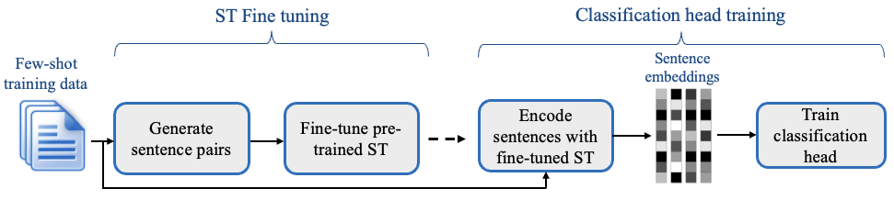
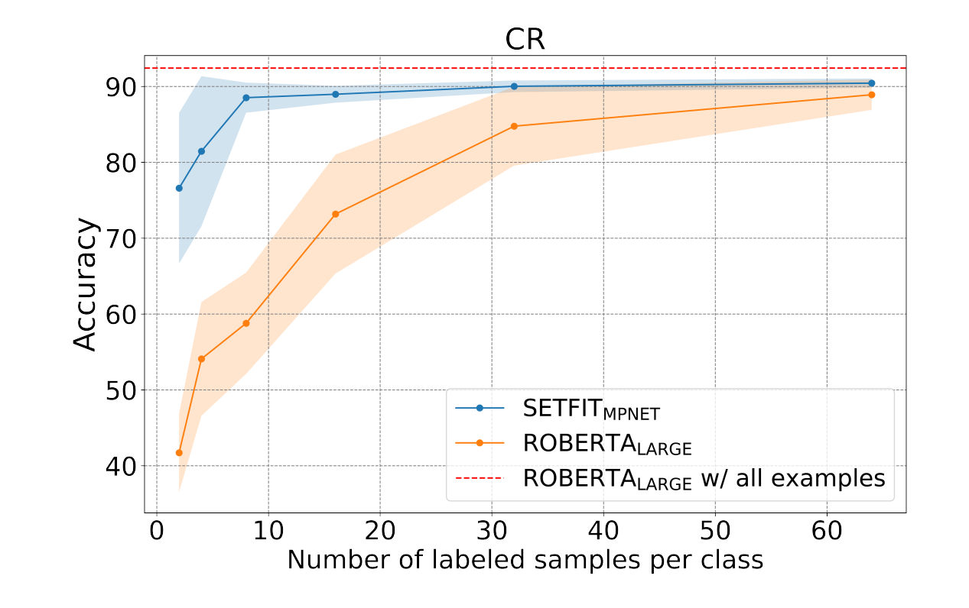
SetFit - Efficient Few-Shot Learning Without Prompts
https://huggingface.co/blog/setfit

Slide 29
Walk through LLM training on CPU
https://colab.research.google.com/github/DJCordhose/practical-llm/blob/main/Assessment_SetFit.ipynb

Slide 30
30 Minuten

Slide 31
Present - quantized / smaller Decoder Models

Slide 32
Architecture Decision: Decoder vs Encoder
General models
Can generate answers
Work without training
Might also benefit from few shot learning
Are extremely costly to train, impractical for almost everyone
Context sizes vary (depending on the Model)
with large contexts certain positions might be blind spots
Memory consumption grows with context used
Response time grows with tokens produced
Inference on GPU

Slide 33
Comparing suitable NVDIA GPU microarchitectures
Commodity: available for small €
T4/RTX 20: https://en.wikipedia.org/wiki/Turing_(microarchitecture)
V100 - professional variant of RTX 20 consumer line: https://en.wikipedia.org/wiki/Volta_(microarchitecture)
A100/RTX 30: https://en.wikipedia.org/wiki/Ampere_(microarchitecture)
L4/L40/RTX 40: https://en.wikipedia.org/wiki/Ada_Lovelace_(microarchitecture)
H100 - professional variant of RTX 40 consumer line, not available on Colab (yet?): https://en.wikipedia.org/wiki/Hopper_(microarchitecture)

Slide 34
Architecture Decision: What can we work with?
Limiting factor is GPU RAM
T4 : 16GB
A100 : 40GB/80GB
L4 : 24GB (L40: 48GB)

Slide 35
Limiting factor is GPU RAM: Quantization
Typical resolution is 16 Bit
Each parameter takes 2 Bytes
Transient memory and storage of context comes on top
Varies with
length of context
architecture of model
What about reducing resolution to 8 Bit or 4 Bit (and even 1 Bit)?
Thus cutting memory requirement down to half or quarter?
Overview: https://huggingface.co/docs/transformers/main/en/quantization/overview

Slide 36
Bitsandbytes - Most straight forward approach to quantization
https://huggingface.co/docs/text-generation-inference/conceptual/quantization#quantization-with-bitsandbytes
Deep Dive: https://huggingface.co/blog/hf-bitsandbytes-integration
Can go down to 4 Bits: https://huggingface.co/blog/4bit-transformers-bitsandbytes
inference can be slower than more sophisticated methods (like GPTQ) or full FP16 precision
https://huggingface.co/blog/hf-bitsandbytes-integration#is-it-faster-than-native-models

Slide 37
Huggingface: De facto standard Hub for LLMs
Find the your model: https://huggingface.co/models
Try out models in chat: https://huggingface.co/chat/
Serve model: https://huggingface.co/docs/text-generation-inference/

Slide 38
Architecture Decision: Smaller Model vs Quantiztion
Decision : Quantization
Key-Driver : multi language
Smaller Models:
Microsoft Phi 3 3.8B: https://colab.research.google.com/github/DJCordhose/practical-llm/blob/main/Assessment_Phi_3_mini_T4.ipynb
Google Gemma 2 2B: https://colab.research.google.com/github/DJCordhose/practical-llm/blob/main/Assessment_Gemma_2_2B_T4.ipynb
Quantization
Meta Llama 3.1 8B - Quantized to 4-Bit and 8-Bit: https://colab.research.google.com/github/DJCordhose/practical-llm/blob/main/Assessment_Llama_3.1_8B_Quantize_T4.ipynb

Slide 39
Hands-On: Quantize Meta-Llama 3.1 8B
LINK ZUM NOTEBOOK

Slide 40
Hands-On: Quantize Meta-Llama 3.1 8B
Criteria
Quality of language
Halluzination
Accuracy
Speed
Memory consumption
Additional task
Concentrate on best model
Check sample in another language
Check for supported languages here: https://huggingface.co/meta-llama/Meta-Llama-3.1-8B-Instruct
In der Gesamtschau der hier vorliegenden Informationen kann nicht erkannt werden, wie die Versorgung des Versicherten mit dem Produkt begründet werden könnte, noch kann die Unbedenklichkeit einer solchen Versorgung bestätigt werden.
LINK ZUM NOTEBOOK

Slide 41
Local machine without NVIDIA GPU
llama.cpp
https://github.com/ggerganov/llama.cpp/blob/master/README.md
https://www.theregister.com/2024/07/14/quantization_llm_feature/
Quantization and optimization
Optimized for Apple Silicon M1/M2/M3/M4
Ollama
Simplifies usage of llama.cpp
https://ollama.com/
https://github.com/ollama/ollama
https://www.theregister.com/2024/03/17/ai_pc_local_llm/

Slide 42
60 Minuten

Slide 43
Coffee Break

Slide 44
Future - larger Decoder Models

Slide 45
Architecture Decision: Big Models on Heavy Hardware ?
There are more powerful versions of OS decoder models available
Rival OpenAI GPT 3.5
Support for major European languages
Quantized versions will run on small GPUs, but far too slow for real world
Useful as demonstration only
Those models will run on available hardware and dedicated inference server
H100 GPUs are are expensive, but available
Inference servers optimize for latency and throughput
https://huggingface.co/docs/text-generation-inference
https://developer.nvidia.com/nim
We can get a preview
https://build.nvidia.com/explore/discover
https://huggingface.co/chat/
The future is already here, it is just not evenly distributed
- William Gibbson

Slide 46
Option: Mixtral 8x7B
Good context length: 24K input, 8K output
explicitly tuned for European languages (like French, Italian, German and Spanish)
only uses fraction of parameters at a time
Reference
https://mistral.ai/news/mixtral-of-experts/
https://huggingface.co/mistralai/Mixtral-8x7B-Instruct-v0.1
Sparse Mixture of Experts (SMoE) Mixtral 8x7B: https://arxiv.org/abs/2401.04088

Slide 47
Option: Llama 3.1 70B
Even better context length: 128k
Supported languages: English, German, French, Italian, Portuguese, Hindi, Spanish, and Thai.
Significantly better scores in European languages than 8B version
Compared to Mixtral 8x7B
significantly better scores all over
Needs more memory and compute
Reference
https://huggingface.co/meta-llama/Meta-Llama-3.1-70B-Instruct
https://ai.meta.com/blog/meta-llama-3-1/
https://llama.meta.com/

Slide 48
Most important general benchmarks for LLMs
MMLU (Massive Multitask Language Understanding)
Evaluates general knowledge and reasoning across 50+ subjects
Includes elementary to university-level questions
ARC Challenge (AI2 Reasoning Challenge)
Tests scientific reasoning and application of knowledge
Derived from standardized science exams for 3rd-9th grade
Includes both multiple-choice and open-ended questions
HellaSwag
Focuses on commonsense reasoning and narrative understanding
Requires predicting the most plausible continuation of scenarios
https://huggingface.co/spaces/open-llm-leaderboard/blog

Slide 49
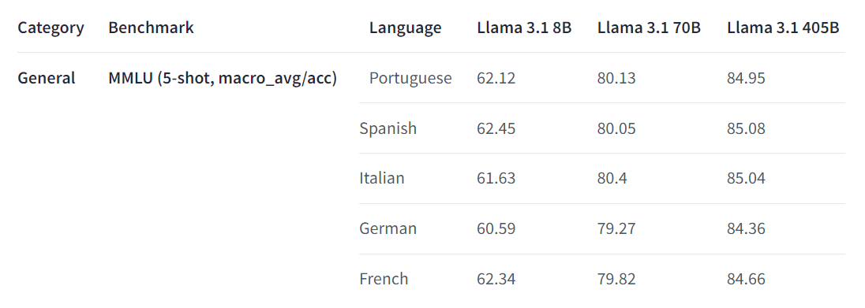
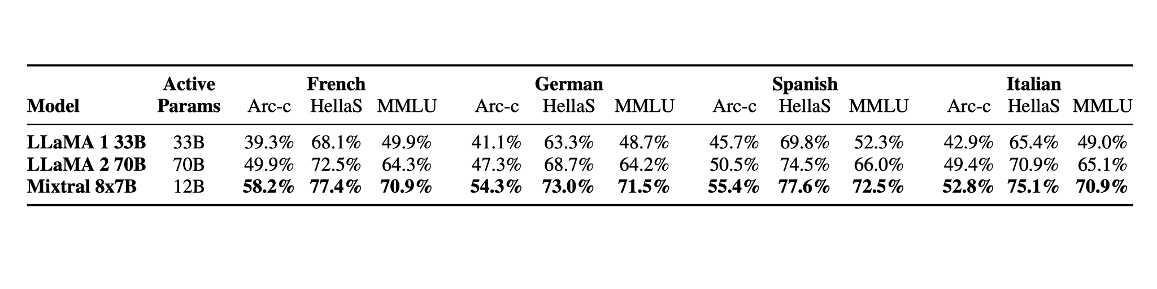
Multilingual benchmarks
https://huggingface.co/meta-llama/Meta-Llama-3.1-70B-Instruct#multilingual-benchmarks
https://mistral.ai/news/mixtral-of-experts/

Slide 50
Can we make this fit into small GPUs?
Mixtral 8x7B will work on L4 and even T4
https://github.com/DJCordhose/practical-llm/blob/main/Assessment_Mixtral_8x7B.ipynb
possible using extreme quantization
Just as a showcase
Not practical
Very slow
Questionable performance

Slide 51
Big Model, Inference Server & GPU
Model can be run as they are, just add a REST API
Better: Inference Server (eg Huggingface text generation interface/TGI)
Batching of requests
Automatic usage of existing hardware
Optimization
Distribute model over multiple GPUs (Tensor parallelism)

Slide 52
TGI - Huggingface inference Server
Supports
LLama and Mixtral Models: https://huggingface.co/docs/text-generation-inference/supported_models
Quantization: https://huggingface.co/docs/text-generation-inference/conceptual/quantization
Streaming of response: https://huggingface.co/docs/text-generation-inference/conceptual/streaming
Optimizations
https://huggingface.co/docs/text-generation-inference/architecture
https://developer.nvidia.com/nccl
https://github.com/vllm-project/vllm
Efficient management of attention key and value memory with PagedAttention
Continuous batching of incoming requests
https://huggingface.co/docs/text-generation-inference/conceptual/flash_attention
https://huggingface.co/docs/text-generation-inference/conceptual/paged_attention
https://huggingface.co/docs/text-generation-inference

Slide 53
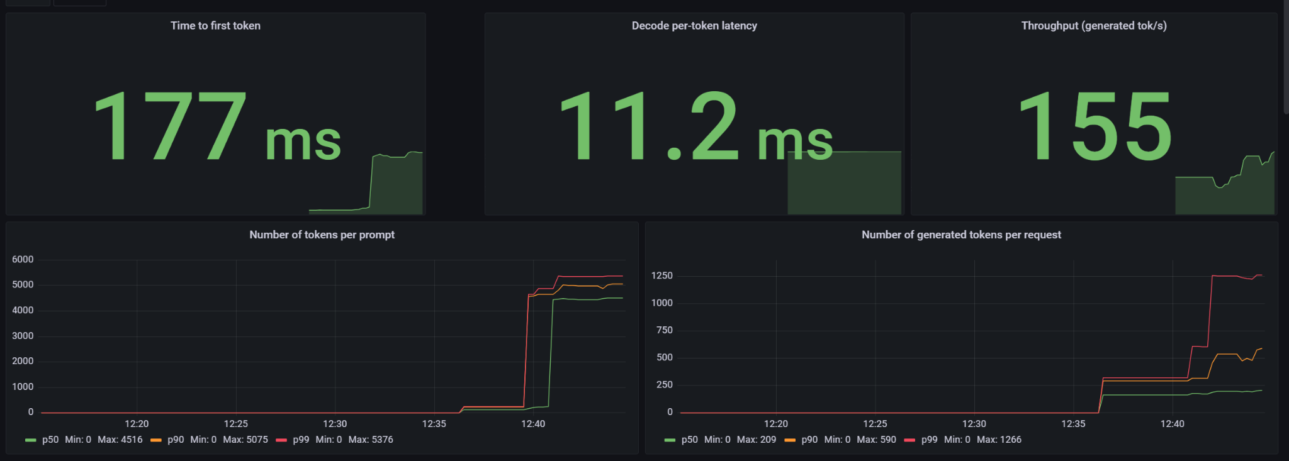
It works: Mixtral 8x7B on 2xH100 NVL using TGI

Slide 54
Hands-On: Try out our models on Huggingface Chat
We do not have the necessary hardware available, but Hugginface has
You can try them out now on Huggingface Chat
https://huggingface.co/chat/settings/mistralai/Mixtral-8x7B-Instruct-v0.1
https://huggingface.co/chat/settings/meta-llama/Meta-Llama-3.1-70B-Instruct
Try some of our standard examples
Try your made up ones
Use languages other than English if you can
Compare to other models available
Which one is your favorite?

Slide 55
GB200- Future successor to both Hopper and Ada Lovelace
https://en.wikipedia.org/wiki/Blackwell_(microarchitecture)
2,5x faster than H100
2x memory
Native support for 4 Bit resolution
Sped up NVLink
https://www.heise.de/news/Nvidias-neue-KI-Chips-Blackwell-GB200-und-schnelles-NVLink-9658475.html

Slide 56
75 Minuten

Slide 57
Evaluation

Slide 58

System Architeture
User:
Asking a Question
question
answer
Llm:
Generating an Anwer

Slide 59
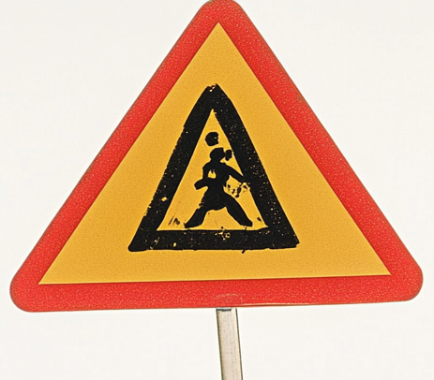



System Architeture
User:
Asking a Question
Doc Loader:
Image2Text
facts
Anonymizer:
Enforcing Privacy
answer
question
facts
SystemPrompt
Question
Facts
facts
Llm:
Generating an Anwer
Vector DB:
Searching facts matching
the question

Slide 60
Evaluation on text results
User:
Asking a Question
Text : answer 1 != answer 2
=> equality not an eval option
Categorical : may use equality for eval
answer
Llm:
Generating an Anwer

Slide 61

Evaluation on text results
Evaluation Criteria:
Generation successful
Length
Correct
Complete
Concise
Relevant
Contradiction free
Language
Style
…
User:
Asking a Question
answer
Statistics
Ground Truth ?
Human Eval
Llm:
Generating an Anwer

Slide 62
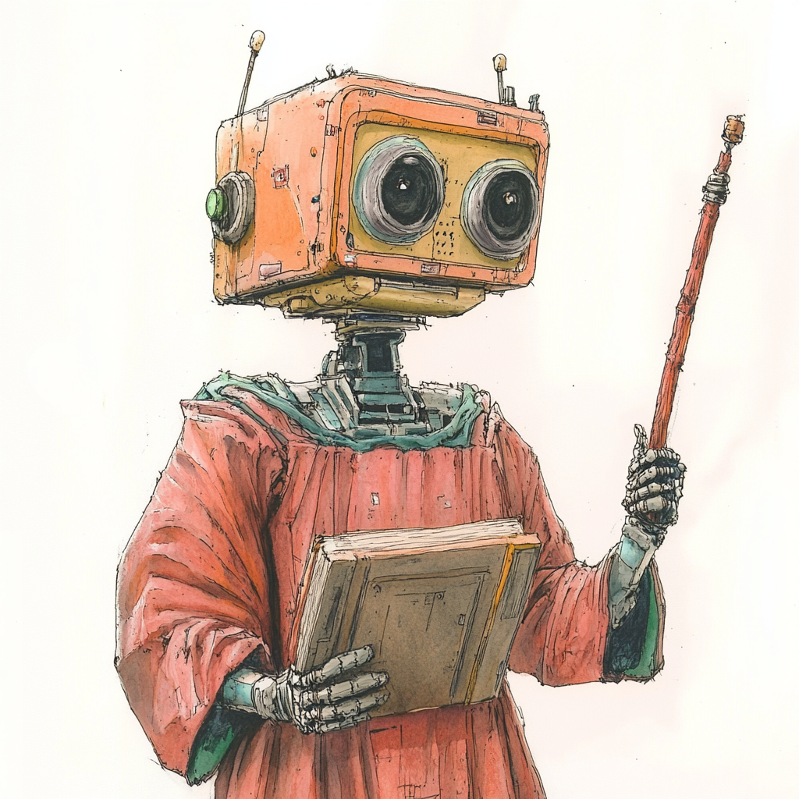
Evaluation on text results
Evaluation Criteria:
Generation successful
Length
Correct
Complete
Concise
Relevant
Contradiction free
Language
Style
…
User:
Asking a Question
answer
Statistics
LLM as a Judge
Ground Truth ?
Human Eval
Llm:
Generating an Anwer

Slide 63
LLM as a judge: example
Prompt :
Input :
Answer :

Slide 64
Hands-On: Try out Evaluation on Prem Notebook
Judge LLM: 4 bit llama 3.1
Fragen & Antworten bereits erzeugt
Simuliert RAG
Antworten von verschiedenen LLMs erzeugt
=> Vergleich Judge gegen die verschiedenen Antworten

Slide 65
Geval: an LLM-as-a-judge algorithm
Idea:
Given a criteria like «conciseness»
Let the LLM create a suitable prompt to evaluate the criteria
Apply the created prompt to the input
Get an numeric answer «the score» and a reason
Criteria :
Input :
Answer :
Score : 0 – 1
Reason : …….

Slide 66
Geval Step 1: From Criteria to Chain-of-thoughts
Prompt :
Input :
Answer :

Slide 67
Geval Step 2: From Chain-of-Thoughts to Score
Prompt :
Input :
Answer :

Slide 68
Needs “Large” LLM: Demo DeepEval using GPT-4o

Slide 69
System Architeture: Online Eval
User:
Asking a Question
Doc Loader:
Image2Text
facts
question
Answer Relevance
Conciseness
facts
Contextual Relevance
Anonymizer:
Enforcing Privacy
answer
SystemPrompt
Question
Facts
facts
Llm:
Generating an Anwer
Faithfulness
Vector DB:
Searching facts matching
the question

Slide 70
Online Evaluation vs Offline Evaluation
Online Performance impact on LLM
Eval may call 10x more often, but have less output tokens
Which LLM do you use ? Same ? Faster ? Most Powerful ?
What Dimensions do you eval ?
Toxicity, Conciseness, Answer Relevance ?
Ground Truth available ?
Human Feedback from your users ?

Slide 71
Your Experience ?
Interpretation of the Scores ?
Anyone doing RAG ? In Production ?
Anyone already on Prem ?
Do you do evaluation ? By humans ?
What else do you use for evaluation ?

Slide 72
LLM Drift Detection
score changes a lot
accuracy or
a criteria
distribution changes a lot, e.g.
length of inputs or outputs
processing time / latency
use univariate two-sample tests
choose test based on properties of samples
train an Encoder Model to tell old data from new data
if the model has predictive power, there must be a systematic change
https://www.evidentlyai.com/blog/data-drift-detection-large-datasets
https://www.evidentlyai.com/blog/open-source-llm-evaluation#drift-detection

Slide 73
Finding Drift in Embeddings
Embedding can be generated from text using encoder style embedding model
Can be as simple as raw encoder model without head
https://openai.com/index/new-embedding-models-and-api-updates/
drift detection methods (potentially with dimensionality reduction)
Euclidean distance on average embedding
Cosine distance on average embedding
Classifier model
Share of drifted embedding components
https://www.evidentlyai.com/blog/embedding-drift-detection
Failing Loudly: An Empirical Study of Methods for Detecting Dataset Shift: https://arxiv.org/abs/1810.11953

Slide 74
Eval Frameworks
DeepEval https://docs.confident-ai.com/
Ragas https://ragas.io/
TruLens https://www.trulens.org/
Evidently https://www.evidentlyai.com/
Ares https://ares-ai.vercel.app/

Slide 75
Wrap Up

Slide 76
Key takeaways

Slide 77
Collection of notebooks used
SetFit: https://colab.research.google.com/github/DJCordhose/practical-llm/blob/main/Assessment_SetFit.ipynb
Microsoft Phi 3 3.8B: https://colab.research.google.com/github/DJCordhose/practical-llm/blob/main/Assessment_Phi_3_mini_T4.ipynb
Google Gemma 2 2B: https://colab.research.google.com/github/DJCordhose/practical-llm/blob/main/Assessment_Gemma_2_2B_T4.ipynb
Meta Llama 3.1 8B - Quantized to 4-Bit and 8-Bit: https://colab.research.google.com/github/DJCordhose/practical-llm/blob/main/Assessment_Llama_3.1_8B_Quantize_T4.ipynb
Meta Llama 3.1 8B: https://colab.research.google.com/github/DJCordhose/practical-llm/blob/main/Assessment_Llama_3.1_8B_Full_T4.ipynb
Mixtral 8x7B with extreme quantization: https://github.com/DJCordhose/practical-llm/blob/main/Assessment_Mixtral_8x7B.ipynb

Slide 79



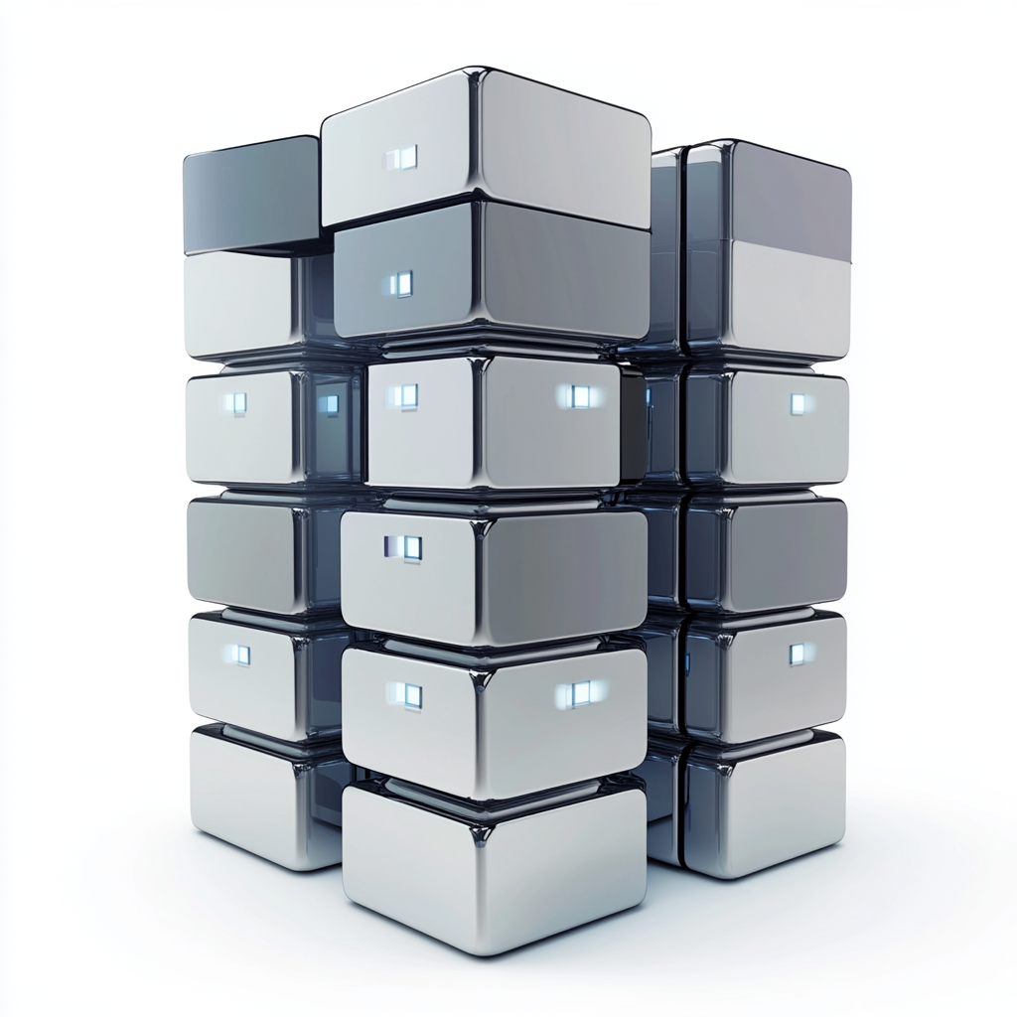


Beware of On Prem
King:
Pose a question
Answer relevant ?
Idea: Create Questions for Answer.
Are the similar to original question ?
Found facts relevant ?
Idea: % of facts relevant for query
Llm:
Create answer
Vector DB:
Find matching facts
Answer based on found facts ?
Idea: Create Statements from Answer.
% of Statements based on found facts.

Slide 80
Evaluation
Especially important for smaller / less accurate models
Standard Benchmarks only faint indication for actual task at hand
Need for a specialized evaluation set very likely

Slide 81
Quantitative vs Qualitative Evaluation
Quantitative Evaluation - Objective Measurement
measure performance objectively
common metrics: accuracy, precision, recall, F1-score, and mean squared error.
Qualitative Evaluation - Subjective Assessment
understanding and interpreting non-numerical data (e.g., text, images, or videos)
obtain deep insights into the underlying phenomena

Slide 82
Quantitative Evaluation for LLMs
A number is what we wish for
Single value
Speaking
Significant
Objective
However: What can be measured objectively often is not significant

Slide 83
Qualitative Evaluation for LLMs
A subjective “feeling” / “impression”
What we often have to resort to
Works best with small set of hand picked examples
If larger amounts needs more sophisticated approaches
Embedding -> Dimensionality Reduction -> Clustering
LLM as a judge

Slide 84
Regression Testing
Checks for stability and degradation of criteria / properties
Challenged when changing
Prompts
TAG-Sources
Model Version
Model Architecture

Slide 85
Criteria Tests
Text statistics. Evaluate simple properties like text length.
Text patterns. Detect specific words or regular patterns.
Model-based evals. Use ready-made ML models to score data (e.g., by sentiment).
LLM-as-a-judge. Prompt LLMs to categorize or score texts by custom criteria.
Similarity metrics. Measure semantic similarity between pairs of text.
https://docs.evidentlyai.com/get-started/tutorial-llm

Slide 86
LLM-as-a-judge
Use the most powerful LLM you have at hand as a judge for an answer
Request categories in prompts
Scores often do not work very well
Explanation texts only make judgements hard to track
Describe the category to test well
Use Judge as part of a conversation or on output only
Example:
Personally identifiable information: https://www.evidentlyai.com/blog/open-source-llm-evaluation#llm-as-a-judge
Conciseness: https://docs.evidentlyai.com/get-started/tutorial-llm#llm-as-a-judge

